Slide 1




COMPANY
PROFILE

Slide 2

Message from
Managing Partner
“SPARK” is an unparallel Garment buying house in Bangladesh strictly adhering to international standard of quality garments since 2009. It has been rendering widespread buying, sourcing, producing & product development service for all apparel buyers since its inceptions. It is a one stop buying management house ensuring world class quality products as well as arranging product of garments of all kind & ranges with quick turnaround
“SPARK” is running with well qualified , well experienced and results oriented individuals in the global market. We ensure you to cater high quality garments which can compete global market to make sure continue fascinating journey within the new revolution.
We welcome you to visit our Cooperate office at Uttara, Dhaka Bangladesh and as well as associate factories with the assurance that you will certainly be satisfied with our performance and working environments.
We look forward to the coming days with determination to remain faithful to our customers/clients. May Allah guide us and help us in every step of our profession.
Muhummad Hasan

Slide 3


Contact
Name of company | SPARK TEXTILES - (sister concern of SPARK I’national )
Year of Establishment | 2009
Nature of Business | 100% Export Oriented Garments Buying & Selling
Corporate Oﬃce Address Location | House No.30/C, (10th Floor), Road #2, Sector 3, Uttara Model Town, Dhaka -1230, Bangladesh.
E-Mail | info@sparktextiles.com
WEB | www.sparktextiles.com
Contact Person | Nayani Meegoda - Business Head
Contacts | 008801714999823 ; nayani.meegoda@sparktextiles.com

Slide 4




Our Locations
jjjjsuhs
Spark Textiles
16, Hanwell Close, Boulton Moor, Derby,
DE24 5DN,
United Kingdom
+44 7712 187696
Spark Textiles
Via Pietro Crespi no 6
Cap 20127
Milano,
Italy
+393298059594
Spark Readymade Garments Trading
New industrial Area,
P.O Box Bo- 9124
Ajman
UAE
+971 6 743 4408, +97150 630 4078

Slide 5



SPARK TEXTILES is a well-established reputed Garments buying house in Dhaka, Bangladesh. We have an experienced and hardworking sales, procurement & quality control team, which can provide you with a complete service supplying quality garments at competitive prices. SPARK TEXTILES - Management have strong integrity and accountability with professional well experienced in this trade locally and globally with good reputation. Management always having close monitoring system to track out all the buyer queries and special focus to new accounts till team is building up the proper rapport.
You are warmly invited to visit our oﬃce in Bangladesh or please proceed the schedule a time for SPARK TEXTILES management team to communicate with you

Slide 6




Our Services
Sourcing
Supplier Identification: Our dedicated research team continuously identifies new suppliers based on their product range, financial status, infrastructure, man power and efficiency of management. Also, our dedicated team continuously updates relevant information on new manufacturers and new products so you can get the best supplier data for your needs. Even advanced information pertaining to new varieties of value additions, fabric, accessories, new technology area and quota availability is also updated. You can rest assured; SPARK TEXTILES is your fresh, relevant and most advanced supplier data informer.
Sampling
SPARK TEXTILES is having own samples section and we can develop 50-100 pcs sample per day. We also gives you competitive edge over other importers by providing samples. We assure samples are developed to suit the season’s colors, fabric and style based of our buyer’s requirements. Just tell us your requirements and we’ll courier samples to you directly. By offering this crucial service, we assist your marketing efforts in your own country and giving you the needed edge for more sales

Slide 7



Our Services
Quality Management
SPARK TEXTILES closely monitors your orders from sampling to shipment. Status on sampling, production and shipment are send to buyers regularly. We maintain a pro-active approach towards identification of problem areas and corrective measures are taken immediately to ensure timely deliveries. We are dedicated to a complete customer satisfaction, and frequent reporting and highly responsive customer support are just our tools to your utmost satisfaction!
Status Reporting
For a transparent process, status reports based on the multi-state inspections are transmitted to you by fax or email. Also, the production progress is analyzed in relation to the delivery terms and suitable course of actions taken to ensure goods are delivered in time. The consignment is allowed for shipment if only it is up to the buyers required standard. It is easy to see that all these sourcing and management services will not only save you time, frustration and fear of the unknown, but it will save you money!

Slide 8




Our Services
Quality Control / Assurance
Our Quality Controllers visit the factory regularly to make sure we meet our Buyer’s requirements. Our quality control personnel are stationed at all manufacturing sites to ensure that all production will meet according to buyer’s requirement. We always want to deliver satisfaction to our customers; We monitor the order from sourcing of raw materials and accessories to production and up to the final shipment goods. We also monitor and report the status of the order to the buyer with systematic follow up on each and every stage
Packaging
Only approved goods are packed and buyer is assured of getting quality merchandise.
Care is also taken to see whether all packing instruction of the buyer are respected.
Shipment / Cargo Handling
All shipping documents reviewed and verified as per buyer instruction. All cargo is handled by reputable forwarder to obtain correct Information regarding ETD and ETA of vessels because time is as important for us as it is to the buyer.

Slide 9









Values
Foster innovation
Meeting Deadline
Innovation is what we always strive for. SPARK fashion and cost effective products are its outcome
Everything we produce meets required quality and agreed lead time
Entrepreneurship
Committing ethical business
Identify and capitalized opportunities through value addition and creation
Integrity and honesty are our principles to ensure ethical business. Being fair to customers, suppliers, employees and also reduce environmental degradation.
Customer satisfaction
Innovative and quality products , at fair price and on time delivery through dedicated team efforts; are key to satisfy our customers
Social Responsibility
Sustainable development through environmental friendly initiatives

Slide 10



OUR MISSION & VISION
Mission
To grow seamlessly of fast paced fashion industry by ;
Ensuring in time delivery with right quality garment to global market
Being innovative, cost effective and globally competitive
Providing opportunities of growth for all employees and improve people’s lives
Vision
To be the most chosen garment supplier in Bangladesh for global clothing companies with the philosophy of VALUE FOR QUALITY

Slide 11








Our Products
Products
SPARK TEXTILES cater all kind of garment/apparel and follow buyer’s requirement.
Woven Garments
Shirts, Denim Long Pants, Twill Long Pants, Long Cargo pants, Short Cargo Pants, Shorts, Skirts, Bottoms, Tops & Jacket etc.
Knit Garments
T-Shirts, Polo- shirts, Legging, Jogger & Sweaters

Slide 12
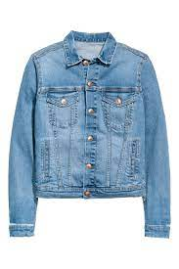
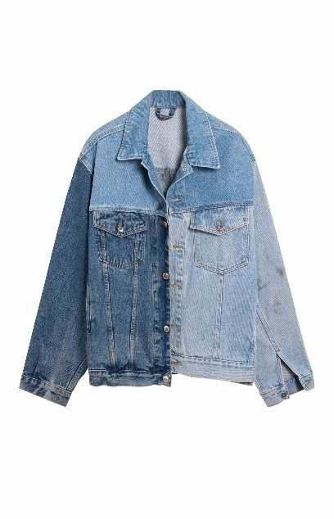
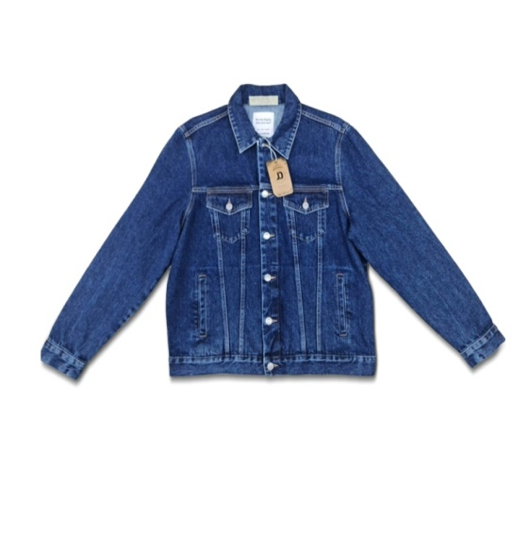
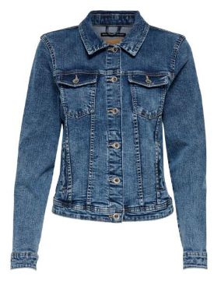
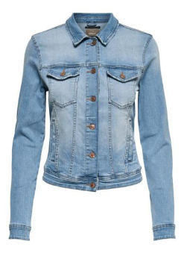
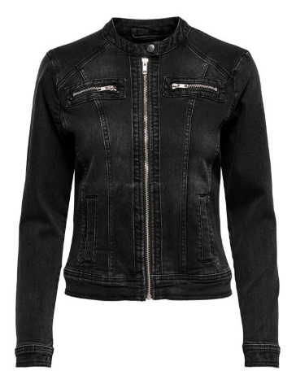
J
A
C
K
E
T
S

Slide 13
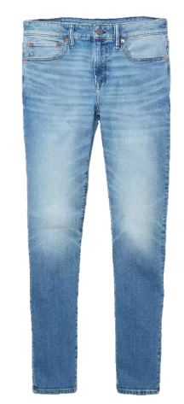
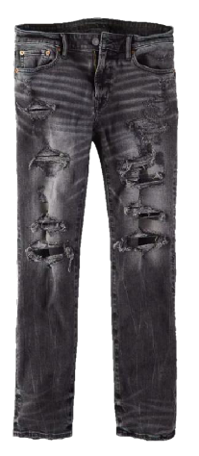
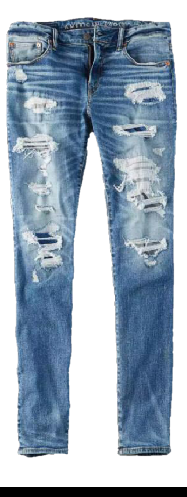
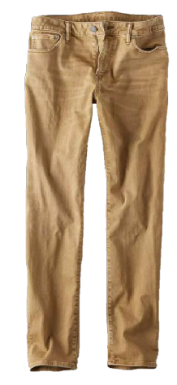
B
O
T
T
O
M
S

Slide 14
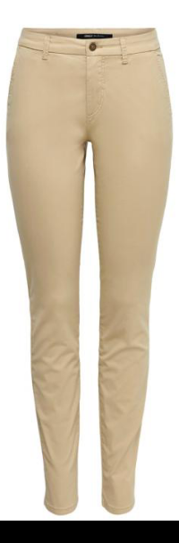
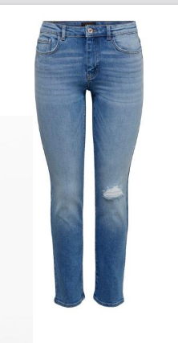
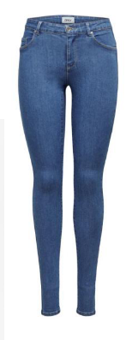
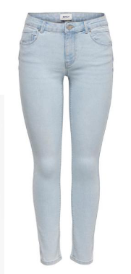
B
O
T
T
O
M
S

Slide 15

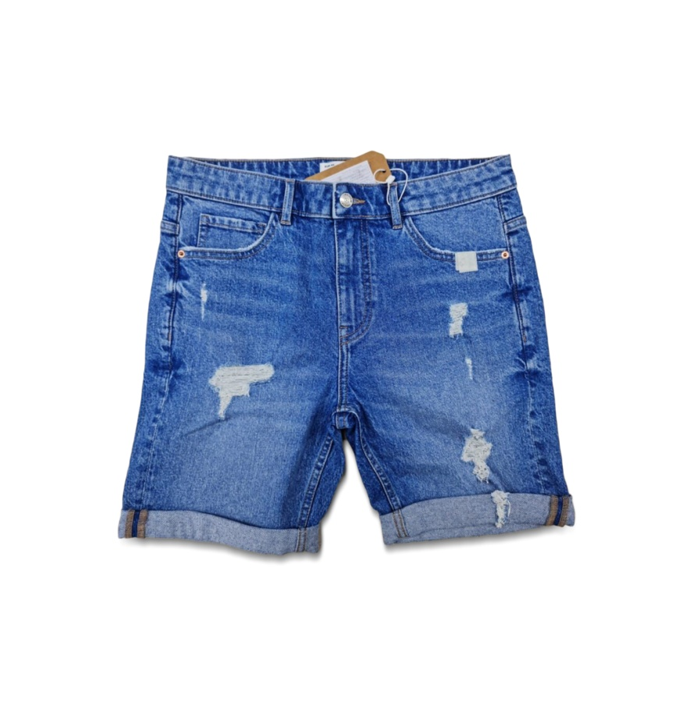
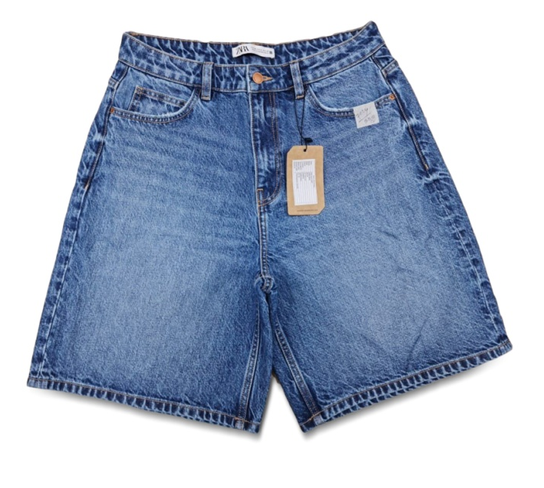
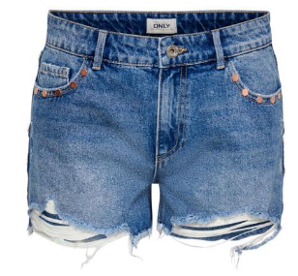

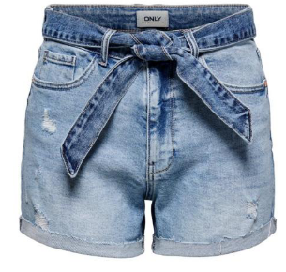
S
H
O
R
T
S

Slide 16
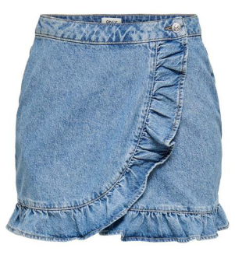
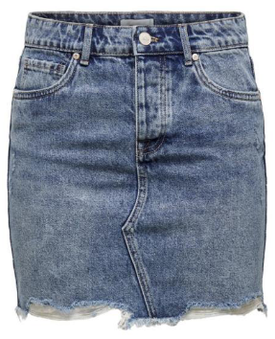
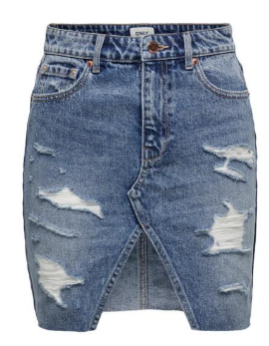
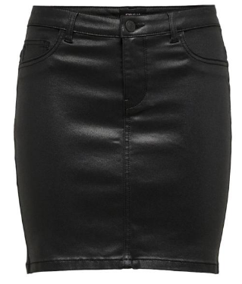
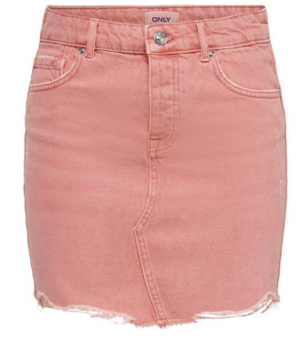
S
K
I
R
T
S

Slide 17

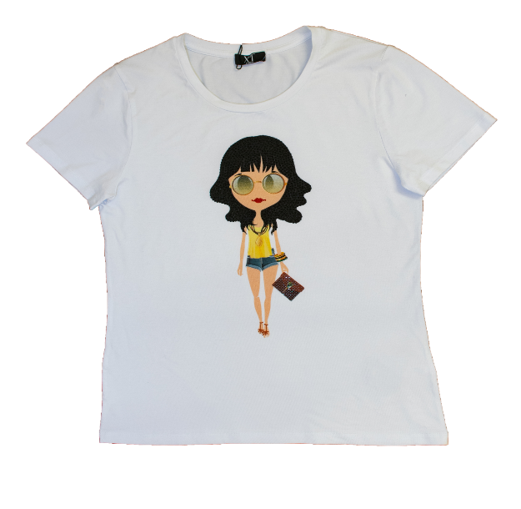
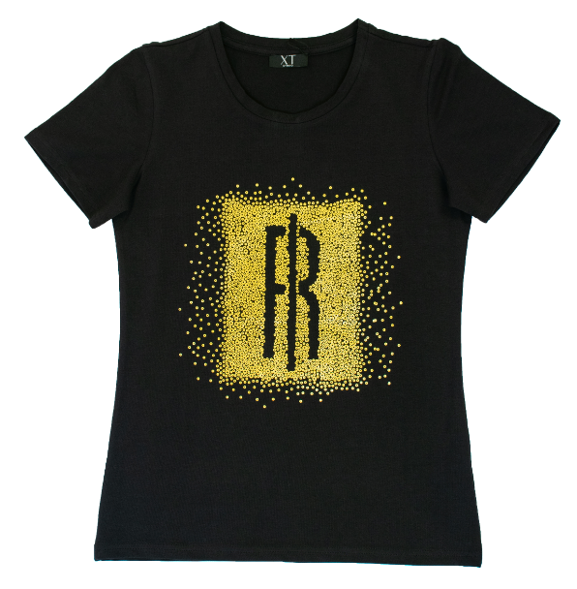


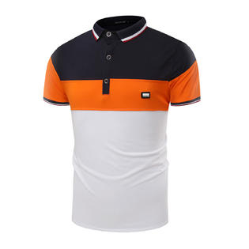
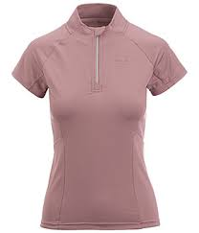
T
S
H
I
R
T
S

Slide 18
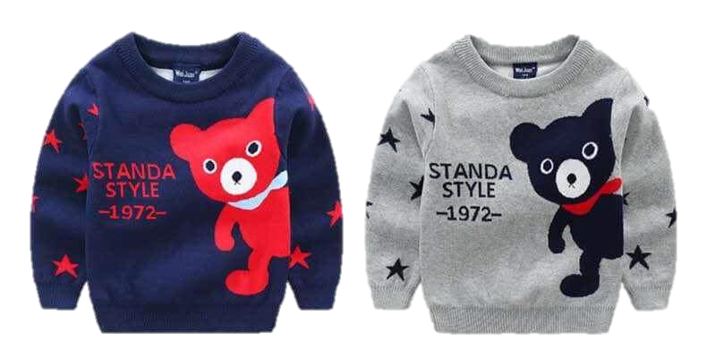
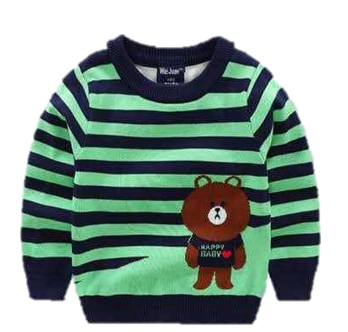
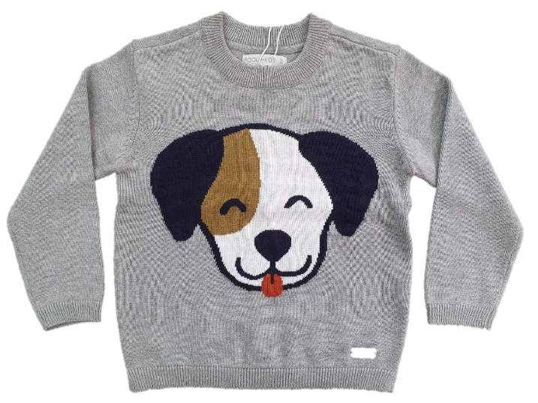
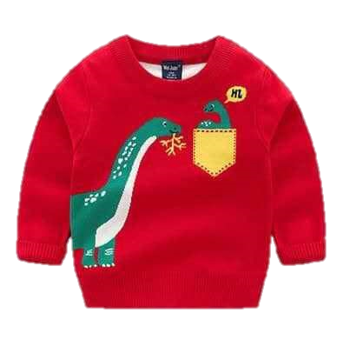
O
T
H
E R
S

Slide 19











Factory Affiliation Certificates
SPARK TEXTILES is dealing with compliant factories such as with all applicable social, ethical, environment and quality systems.
Maintaining sustainable health and safety environment in factories. It is our core and most important task. To achieve this goal we regularly train our manpower with regards to safety standard issues and initiating steps to increase our capacity. Our management team is working proactively to improve the standards where ever it is possible.

Slide 20














Our Clients
We SPARK maintains high standards of integrity, quality and techniques to cater our best to the world class brands. We commit to achieve our best for customers with our long Track expertise records

Slide 21


Sample & Design
Machine Inventory
SL | Machineries | Quantity | Brand
1 | 2 Needle 4 Thread Overlock Machine | 02 set | SIRUBA
2 | 2 Needle 5 Thread Overlock Machine | 02 set | SIRUBA
3 | 2 Needle Double Chain Stitch Picot & Faggoting | 02 set | SIRUBA
4 | Single Needle Lock Stitch Machine | 05 set | BROTHER
5 | Multi needle chain stitch | 01 set | BROTHER
6 | Single Needle Lock Stitch With Auto Trimmer | 03 set | BROTHER
7 | Electronic Lock Stitch Bar Tacker | 01 set | BROTHER
8 | Electronic Lock Stitch Button Attacher | 01 set | BROTHER
9 | Electronic Lock Stitch Button Hole Machine | 01 set | BROTHER
10 | Needle Detector With Defective Hight 10cm | 01 set | OSHIMA
11 | Feed Of The Arm Machine | 01 set | ZUKI, ZUSUN
12 | 3 Needle 5 Th Flat Lock Machine | 02 set | PEGASUS
13 | Electronic Eyelet Button Hole Machine | 01 set | BROTHER
14 | Automatic Snap attach machine | 01 set | TOYO
01 | Flat Vacuum Iron Table | 02 set | UZU
02 | Straight knife cloth cutting machine | 01 set | KM
No. of Machines | 24
Manpower | 15
Square Feet | 1500 Sq.Ft
Product Category | Knit/Woven
Utility | Generator 01

Slide 22

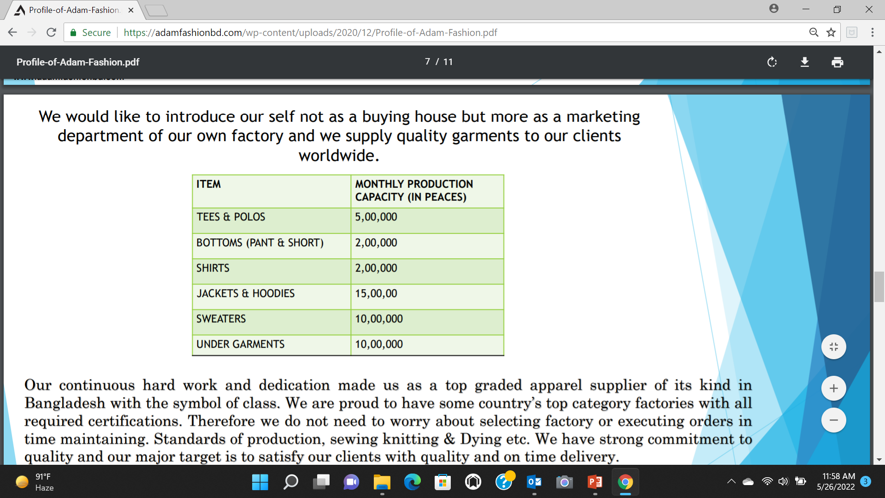

Our Strength
We are proud to have some country’s top category factories with all required certifications. Therefore we do not need to worry about selecting factory or executing orders in time maintaining. Standards of production, sewing knitting & Dying etc. We have strong commitment to quality and our major target is to satisfy our clients with quality and on time delivery.

Slide 23
THANK YOU

